Slide 1
Q1 2026 FYARRO Business Review

Slide 2
Topics
Q1 Fyarro National and Regional Performance
Sales and Marketing Updates
Business Insights & Analytics
Market Access
Advocacy

Slide 3
March 2026 FYARRO Performance & Inventory

Slide 4
March Sales Performance
Demand +17% vs Budget; Net Sales $4.25M, +$1.5M / +54% vs Budget
Daily average demand (Recent 14 Months)
Revenue Progress Bar
Net sales by Quarter- LTD ($M)
+17.8%
+0.9%
+10.5%
Daily average demand units:
Q1-26 ended strongly compared to budget with a 7% favorability
Draft Net Sales March compared to Budget
Mar’26: $4.25M ; +$1.5M / +54% ; QTD: $9.42M ; +$0.9M / +10% ; vs Q4-25: -$1.6M / -14%
Aadi Bio Kaken 2026 net sales budget : $36.2m
Mar Month – 22.6 units
vs Budget: +3.1 / +17%
vs Feb: +2.3 / +12%
QTD – 20.9 units
vs Budget: +1.4 / +7%
Net Sales and Demand data are updated through 03/31

Slide 5
Demand
Q1 actuals ahead of budget

Slide 6
Inventory at Specialty Distributor
Total Days on Hand (DoH) at 13
SD Inventory (DoH) as of Mar’26
DoH – Jan’25 to Mar’26 movement
Total inventory stood at 13 days, reflecting a stock of +5 days in March
Mckesson Plasma And Biologics at normal inventory level of 2-3 weeks
McKesson Specialty at 8 days of inventory; back to normal levels
Cencora at 2 days of inventory at the end of March; replenished to 6 days in the first week of April.
Mckesson Plasma And Biologics and Cencora, are major customers ~ 44%
Mckesson Specialty is the smallest SD with 20% of the business
Tanner commenced direct purchases from Aadi, no inventory maintained as they buy for existing demand
Days on Hand calculated using inventory ending Mar’26 and Valid Demand in Mar’26; Portion of Business calculated using Demand vials YTD;
CENCORA: (ASD + Oncology Supply), MPB: Mckesson Plasma And Biologics, MSH: Mckesson Specialty

Slide 7
Net Sales and Demand
Commercial Demand (Daily Average)
Net Sales ($M)- Act (Mar) vs Budget
Net Sales- %Growth
YTD
QTD
Mar’26
28%
-15%
59%
vs PYTD
vs PQTD
vs Feb’26
Source of Business and Account metrics
Source of Business-YTD
Sarcoma Centers Penetration – (65)
Top 25 Parent Accounts
Child Accounts Breadth and Depth
LTD Accounts:
369
Strong 2026 with 20.9 daily demand average; slightly below (-4%) a very strong Q4
Patients per account (Depth) was stable in Q1 coming from Q4, decline in #ordering accounts (Breadth)
Top 25 Accounts declined less (-3%) vs Non-Top 25 accounts (-6%), however no major differences
Performance was flat in Jan and Feb, with strong pickup in March (+12% over Feb), shared across all regions
85%
1. PAP vials are included for Source of business, Account metrics, and Sub-Nation metrics
2. PYTD-Previous year till date; PQTD-Previous quarter till date;
3. Duration estimation Veeva claims- patients starts till Dec’23 were considered to have enough look-forward data
4. 340B data is updated till 03/31/2026
5. R4W 03/07/2026 – 04/03/2026; P4W 02/07/2026 – 03/06/2026; PP4W 01/10/2025 –02/06/2026;
R8W 02/07/2026 – 04/03/2026; 2025TD 01/01/2025 – 03/31/2026; YTD 01/01/2026 – 03/31/2026;
QTD 01/01/2026 – 03/31/2026

Slide 8
Q1’26 Performance: Central
Demand was slightly higher in Q4, followed by a 9% decline in Q1
Demand Vials by Quarter
The overall breadth continues to stay strong, indicating a consistent base of ordering accounts over time (>=40); minor dip in Q1 vs Q4
Minor depth declined in Q1, primarily driven by reduced activity from non–Top 25 accounts, which had higher contribution in Q4’25; additionally, long-standing accounts such as Oncology-Hematology Associates and Atrium reported zero orders in Q1
Cancer and Hematology Centers was the biggest growing account
Top Contributors to Growth | Q4’25 Vials | Q1’26 Vials | Change | Change %
Cancer And Hematology Centers of Western Michigan PC | 6 | 27 | 21 | 350%
Northwestern Medicine | 22 | 40 | 18 | 82%
Texas Oncology PA | 45 | 62 | 17 | 38%
Depth
Breadth
Top Decliners | Q4’25 Vials | Q1’26 Vials | Change | Change %
University of Michigan | 34 | 2 | -32 | -94%
Oncology-Hematology Associates of Central Illinois PC | 18 | 0 | -18 | -100%
Atrium Health | 16 | 0 | -16 | -100%
(-5%)
(-4%)
Breadth is defined as #accounts with demand in respective quarter;
Depth is #vials per ordering account in respective quarter

Slide 9
Q1’26 Performance: East
Demand grew by 7% in Q1, continuing its upward trend
Demand Vials by Quarter
Breadth of ordering accounts has remained flat since Q3
Depth has shown a consistent upward trend with increased ordering from active accounts like NYU Langone and Univ of Rochester (Non-Top 25 accounts)
Mass General was the biggest grower in Q1 after no orders in Q4
John Hopkins and Univ. of Virgina were the biggest decliners
Top Contributors to Growth | Q4’25 Vials | Q1’26 Vials | Change | Change %
Mass General Brigham Inc | 0 | 26 | 26 | Reactivated
NYU Langone Health | 12 | 28 | 16 | 133%
University of Rochester Medicine | 6 | 22 | 16 | 267%
Depth
Breadth
Top Decliners | Q4’25 Vials | Q1’26 Vials | Change | Change %
Johns Hopkins Medicine | 16 | 0 | -16 | -100%
University of Virginia Main Campus | 16 | 0 | -16 | -100%
Regional Cancer Care Associates LLC | 16 | 2 | -14 | -88%
(7%)
(0%)
Breadth is defined as #accounts with demand in respective quarter;
Depth is #vials per ordering account in respective quarter

Slide 10
Q1’26 Performance: West
Demand peaked in Q4 and dropped substantially in Q1
Demand Vials by Quarter
Breadth of ordering accounts has declined consistently across quarters, with a 21% drop in Q1
Depth improved from Q3 to Q4 but slightly softened in Q1, remaining above Q3 levels
Kern County was the biggest growing account; while Allison Curtis (CCC Nevada) was the biggest decliner
Top Contributors to Growth | Q4’25 Vials | Q1’26 Vials | Change | Change %
Kern County | 0 | 14 | 14 | Reactivated
Fred Hutchinson Cancer Center | 9 | 17 | 8 | 89%
City of Hope | 2 | 8 | 6 | 300%
Depth
Breadth
Top Decliners | Q4’25 Vials | Q1’26 Vials | Change | Change %
Allison Curtis Kingsley Meoz Michael & Sanchez PC (CCC Nevada) | 26 | 2 | -24 | -92%
University of Nebraska Central Administration System Office | 20 | 6 | -14 | -70%
UNM Health System | 18 | 4 | -14 | -78%
(-6%)
(-21%)
Breadth is defined as #accounts with demand in respective quarter;
Depth is #vials per ordering account in respective quarter

Slide 11
Q1 2026 Marketing Highlights

Slide 12
2026 FYARRO Strategic Imperatives (SIs) and Tactical Objectives
Our strategy focuses on activating impactful leverage points across the patient journey where targeted action can most directly influence patient identification, treatment initiation, and duration
  Expand FYARRO’s Role as the 1L Standard in mPEComa
  Increase Awareness of Sarcoma Misdiagnosis to Enable Earlier, Accurate Identification
Ensure a Positive FYARRO Treatment Experience
SI 1
SI 2
SI 3
Build on sarcoma specialist leadership to sustain momentum and reinforce confidence in FYARRO beyond their own practice settings
Accelerate adoption among high-potential community and gynecologic oncologists by translating established sarcoma experience into broader clinical practice
Empower patients and caregivers with education and tools that support informed treatment selection
Elevate awareness that malignant PEComa is frequently misdiagnosed, particularly in community and non-specialist settings, potentially delaying appropriate treatment
Activate upstream stakeholders, including surgical oncologists and pathologists, to support early and accurate diagnosis and increase patient flow into the funnel
Sustain partnerships with patient advocacy groups to support patients and families navigating malignant PEComa diagnosis and treatment
Reinforce clear expectations and proactive therapy management to support sustained treatment duration
Align multidisciplinary care teams, including oncologists, nurses, and pharmacists, to optimize patient retention
Maintain seamless access and support to enable timely initiation and continuity of therapy
Tactical Objectives
*FYARRO is an mTOR inhibitor indicated for the treatment of adult patients with locally advanced unresectable or metastatic
malignant perivascular epithelioid cell tumor (PEComa)

Slide 13
Delivering on the strategy
Updated core promotional materials with the NCCN Guideline update to enhance FYARRO clinical relevance
Elevated the “novelty of nab” messaging to drive continued FYARRO differentiation
Increased focus on Gyn-Onc approved messaging to support FYARRO’s core patient population and high-potential opportunity
Onboarded new media partner and developed 2026 plan to strengthen reach and engagement with high-value HCP and patient audiences
Presence at SGO 2026 and Planning for 2026 Congresses/Sponsorships
Onboarding of Marketing Consultant

Slide 14
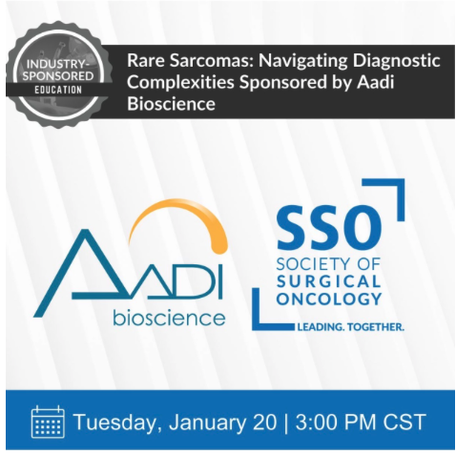
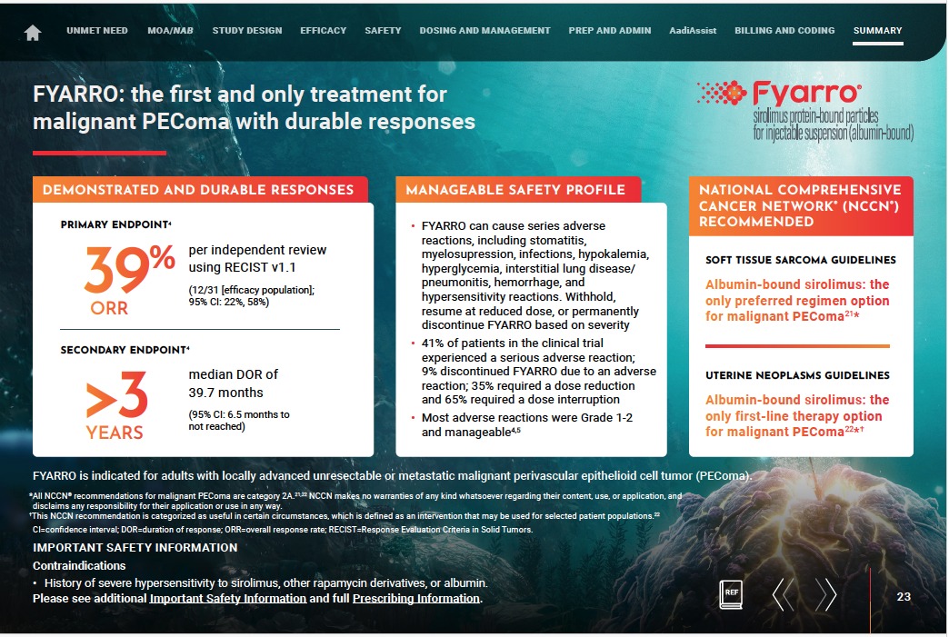



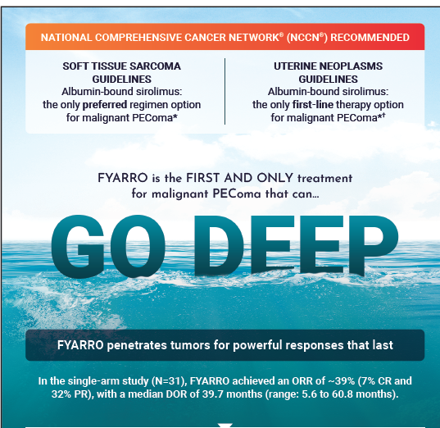
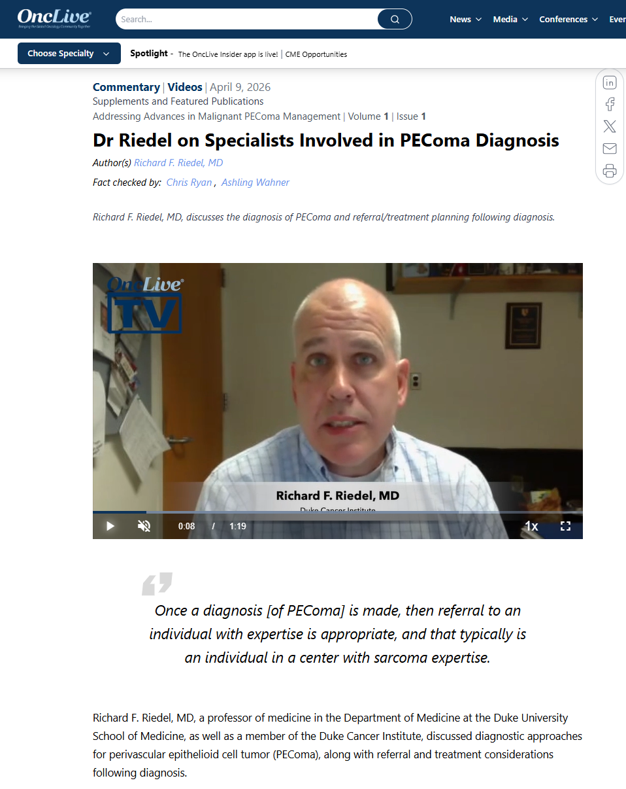

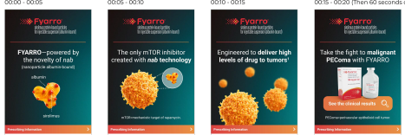
Q1 tactical execution to pull-through strategy to key audiences
HCP PROMOTION
PEER TO PEER DIGITAL EDUCATION
Audiences: Sarcoma Specialists, Community, Gyn-Oncs, APPs, Pharmacists, Reimbursement Specialists
Core Visual Aid (Print & Digital)
Treatment Guide (Print & Digital)
Audience: Surgical Oncologists
Goal: Increase early diagnosis
Gyn-Onc Brochure and Banner Ads
Fyarro Quick Hits Leave Behind
Audience: Oncology Pharmacists
Goal: Increase awareness of PEComa and support proper patient management
Audience: Community, Gyn-Onc
Goal: Increase accurate diagnosis
Nab-It MOA Focused Banner Ads

Slide 15

On the Horizon for Q2
Update branded speaker deck
Unbranded speaker training
5 years of FYARRO Campaign
Sarcoma Awareness Month Planning
Aadi Assist Resource
Enhanced media strategy for HCPs & patients to increase reach and engagement
Seamless material ordering portal for sales team
FYARRO/Aadi presence at ASCO

Slide 16
Field Sales Team

Slide 17
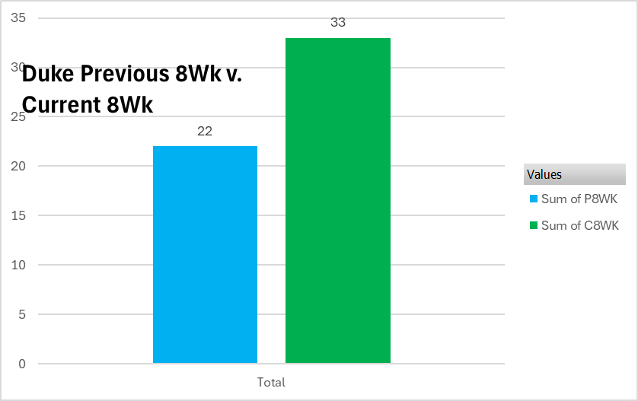
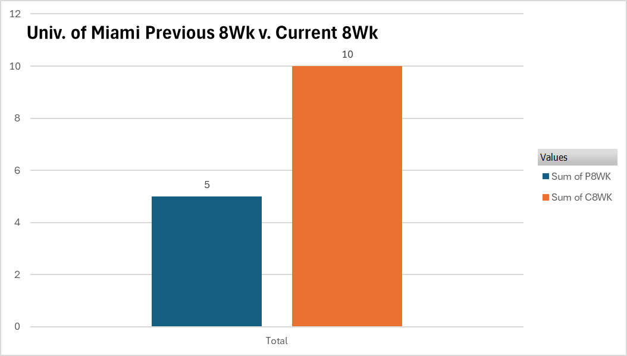
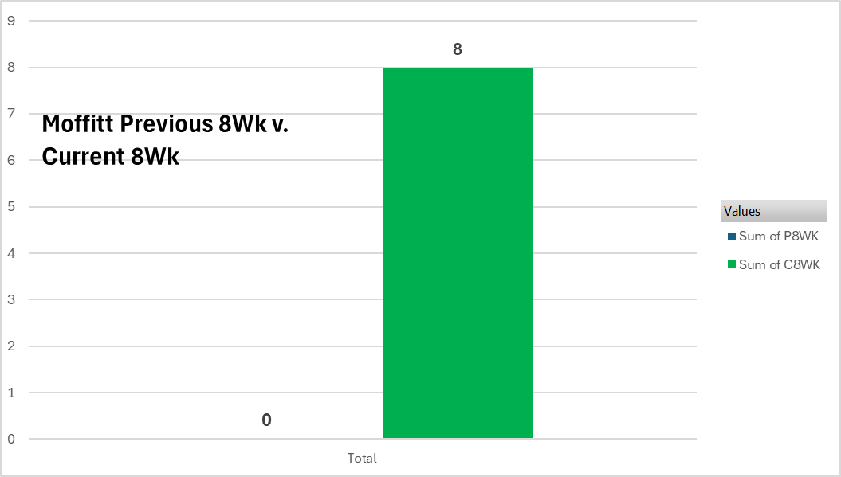


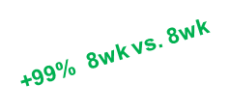
High Impact execution of 2026 account strategy
Focus = Results
Sustain Momentum
Protect and grow demand in top volume accounts
Deepen the Base
Reactivate prior experience accounts
Unlock New Growth
Activate never-written and emerging accounts
Duke Health
University Of Miami
Moffitt Cancer Center- Reactivated Account
+50% R8wk
Jan 15- Met with Dr. Grilley-Olsen,
Feb 5- Met with Grilley Olsen, Gyn Oncs & Pharmacy.
May15- Speaker program
Jan. 22-Met with Sarcoma Team KOLs Dr.s D’Amato, Dr. Trent, at MOSS. HQ partnership with Dr. D’Amato and Women in sarcoma May 30th at ASCO
Jan 23- Met with Dr. Mullinax at MOSS event
April 21 -Attended Sarcoma event April 21.
May 14th - Dinner with Sarcoma team Drs. Druta, Hendricks, Bohl -
Target Focus on Key Accounts- Mix of account site visits and sarcoma events/conferences
50% reach in Top 25 accounts in first trimester despite 2 RBM vacancies
32 Account meetings and appts with Top 75 Accounts
Attended 5 Sarcoma conference & events in March & April
High impact SGO conference with multiple meetings with 9 Gyn Oncologists from key accounts
* Texas Oncology was selected as a high-potential network to implement targeted Fyarro media through geofencing
Notes:
17

Slide 18

Strategic Account Focus
Sustain Momentum
Texas Oncology Pa
Unlock Growth
Cleveland Clinic
Deepen the Base
University of Michigan
Washington University
Duke Health
Northwestern Medicine
Unc Health
University Of Kentucky
University Of Texas MD Anderson
Memorial Sloan Kettering Cancer Center Group
Dana Farber Cancer Institute Inc
Emory Healthcare
Florida Cancer Specialists & Research Institute Llc
Virginia Cancer Specialists P.C.
Johns Hopkins Medicine
Umass Memorial Health Care
Mount Sinai Health System
Nuvance Health(Danbury Hosp)
Dartmouth Health
Virginia Oncology Associates
Upmc Health
Stanford Health Care
University Of Southern California
Kaiser Permanente
Sutter Health
Atrium Health
Franciscan Missionaries Of Our Lady Health System
Froedtert Health
Vanderbilt University
Ssm Health
Rush
Wake Forest
North Shore Hematology Oncology Associates Pc
Maine Center For Cancer Medicine & Blood Disorders Pa
Maryland Oncology Hematology Pa
Christiana Care Health System
University Of Miami
Newyork - Presbyterian Health
Uchealth
Sarcoma Oncology Center
Cedars-Sinai Health System
City Of Hope
Mayo Clinic Hospital Rochester
Cancer And Hematology Centers Of Western Michigan Pc
University Of Tennessee
Fairview Health Services
The West Clinic Pllc
OSU
University of Iowa
University of Indiana
Moffitt Cancer Center
NYOH
Mayo Clinic Jacksonville
Nyu Langone Health
Beth Israel Lahey Health
University of Pennsylvania
Fox Chase
Virginia Commonwealth Univ
Mass General Brigham
UAB
Commonspirit Health
Mayo Clinic Arizona
The Oncology Institute Ca A Professional Corporation
UCSD
UCLA
Huntsman Cancer Center
Compass Oncology
Next Gen- Sankhala
UCSF
Oregon State Health
UC Davis
Univ of Kansas
Tennessee Oncology Pllc
Oncology Specialties P.C.
Rocky Mountain Cancer Centers Llp

Slide 19

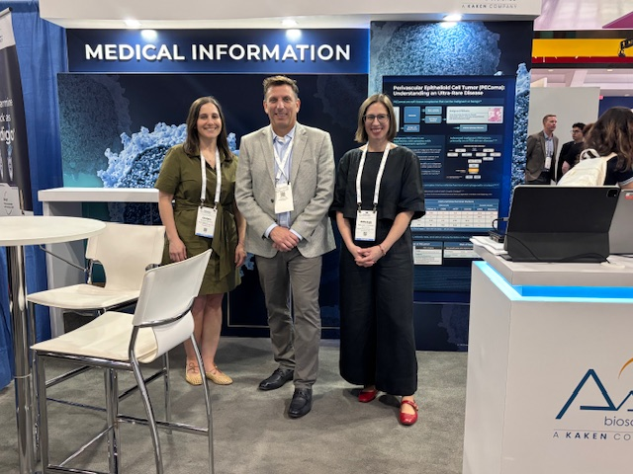

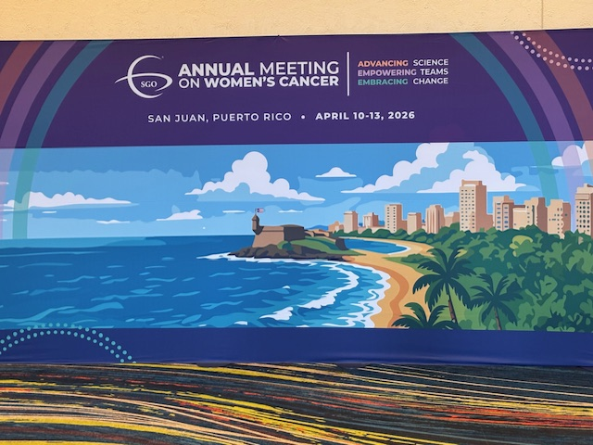
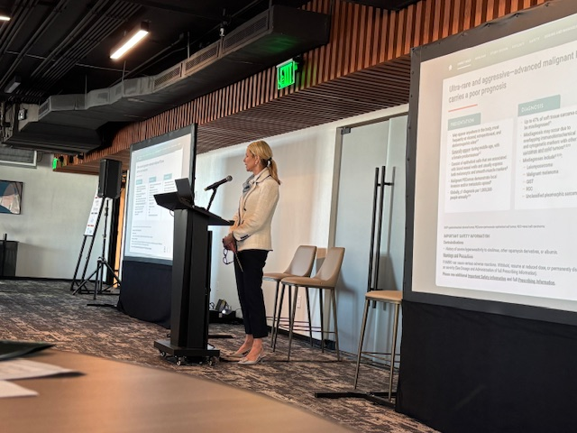
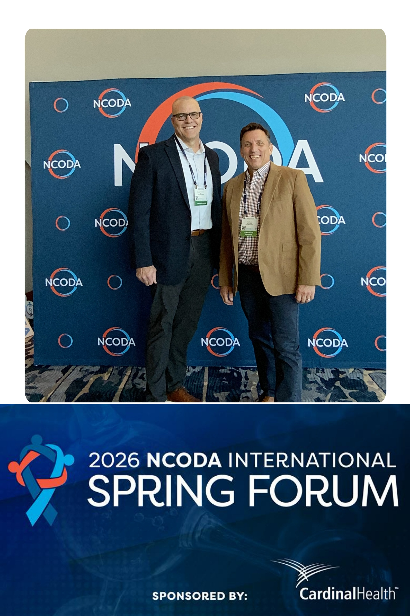
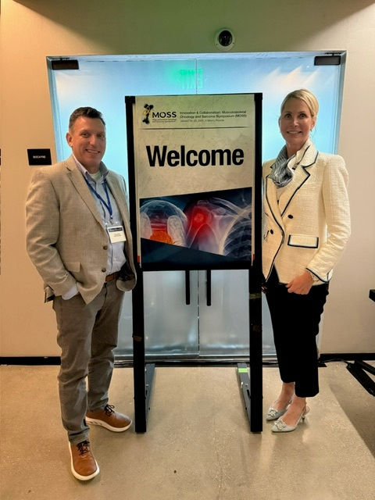

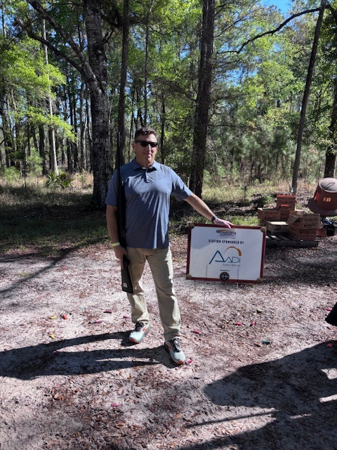
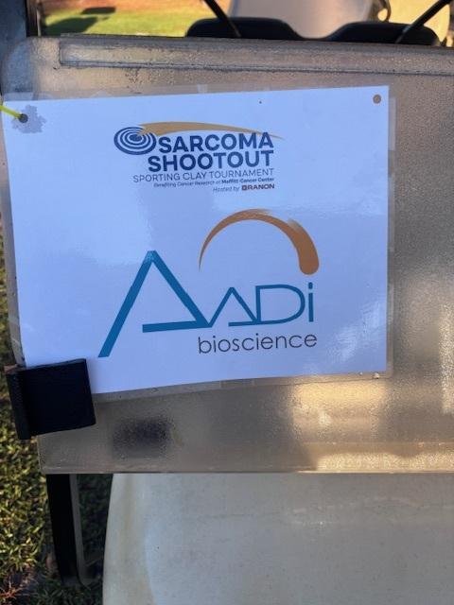


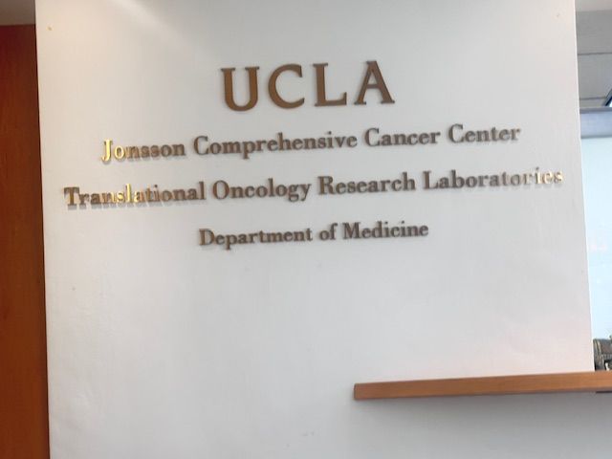
Advancing access to enhance engagement and education

Slide 20
Building a High Performing team…while driving operational excellence
Develops Best Teams
Operational Excellence
Championing a high-performance culture
    Clear expectations, coaching, and accountability
    Designed and implemented standardized Field Coaching Report to ensure consistency
Leading with focus on results, development, and execution
Identified top talent – Full Team !
  RBM West Travis Fonseca started April 13th
    Extensive background in oncology, rare disease, & sales leadership covering West coast
  RBM East Davis Thomason starting in May
    Strong tracked of success in Ultra rare disease Oncology/Non-Oncology on the East Coast.
Refined Account Targeting to continue a strategic and focused approach to maximize impact
Partnered with Sales Ops to elevate sales analytics/reports & PULSE dashboard to improve data driven decisions
Standardized RBM sales training plan to accelerate field effectiveness & readiness
  Disease state and product training
  Targeting and analytics
  Approved messaging and resources
  Product certification
Led re-launch of CRM (Conexus) to re-energize execution, drive momentum, and measure success

Slide 21
Upcoming Appts, Conferences, Mtgs Events
April 15th – 16th – NCODA (Network for Collaborative Oncology Development & Advancement) Community Oncology focus
April 17th-18th- Rocky Mountain Sarcoma Society (Univ. Of Colorado)
May 29th-June 2nd SARC & ASCO in Chicago
June 17-20th WAGO in Napa Valley, CA
July 10th- 11th – LifeFest- Nashville, TN
July 15th -17th – ATTOP- Pharmacy Conference – Wash DC

Slide 22
Market Access

Slide 23
Market Access
Payer Mix Update – Completed Feb 2026
Q2 Price Increase – On track
Upcoming new resource – Aadi Assist Brochure
Upcoming Quarterly Patient Services Review with Sonexus

Slide 24
FYARRO Payer Mix remains predominantly Commercial, with Medicare growing over time.
Other
2%
Broad Payer coverage with > 90% commercial lives and > 95% Medicare lives covered
Commercial payer policies coverage to the label with little to no restrictions (~ 90% covered lives)
Majority of claims are Commercial Payers as is expected in a younger patient population (~50%)
Slight Medicare growth versus prior assessment driven by aging patient population
Aadi Assist in place to support access to treatment
96% of HCPs have reported no access issues while prescribing FYARRO
Medicaid
24%
Commercial
49%
Medicare
26%
Weighted Payer Mix (All Settings)
(n=1,694 Claims)
Source: The Dedham Group February 2026
COPYRIGHT-CONFIDENTIAL

Slide 25
Business Insights and Analytics

Slide 26
New claims data will support positive impact for the FYARRO business
Veeva selected as claims provider based on high level robustness of data and better cost vs. other providers
Insight Area via Claims | Business Impact
Enhanced market clarity | Improved forecast accuracy + market sizing confidence
Focused on key audiences | More effective targeting across sarcoma, gyn onc, and community
Utilization dynamics | Increased positioning vs. competitors (e.g., oral mTOR use), optimized patient flow
Patient experience | Improved persistence and time on therapy
Growth opportunities | Increased adoption in high-potential accounts

Slide 27
Wave 11 Pulse Survey (ATU) with ZS Associates
Kickoff: Week of April 13th
Expected Readout: June
Sample: PEComa treaters (10 med onc; 10 gyn-onc)
Objectives
  Assess brand awareness for Fyarro and current uptake as a treatment for locally advanced or metastatic malignant PEComa, as well as how it varies among different physician types
  Understand physicians’ treatment attitudes, current perceptions of Fyarro relative to its competitors, patient types considered suitable for Fyarro, and any drivers or barriers to Fyarro adoption
  Gauge promotional effectiveness and identify any early successes or challenges in rep execution of the Fyarro launch story

Slide 28
Advocacy

Slide 29


2026 Advocacy Events Have Been Secured Show Aadi’s Commitment to PEComa Awareness
    2026 Race to Cure Events in NJ, LA, Tampa
    Aadi corporate recognition in Chicago and Philadelphia
    2026 Sarcoma Exchange Event - July
    Dragonslayer Sarcoma Run/Walks Portland, Oregon 9/12/2026 and Seattle, Washington 9/19/2026

